Slide 1


Chapter 2

Slide 2
The Physical Layer:
Transmitting Raw BITS over a communication channel. The design issues must take into
considerations:-
Sending “1” must be received “1” not “0”.
How many Volts to represents logic “1” and how many volts represents logic “0”.
How many nanoseconds a bit lasts.
How many pins the network connector has and what each pin is used for.
The design issues deal with mechanical, electrical, and procedural interface, and the physical transmission medum, which lies below the physical layer.

Slide 3
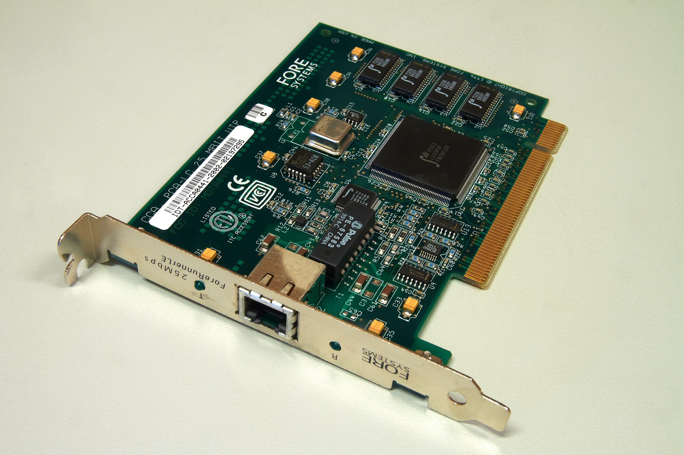

Slide 4
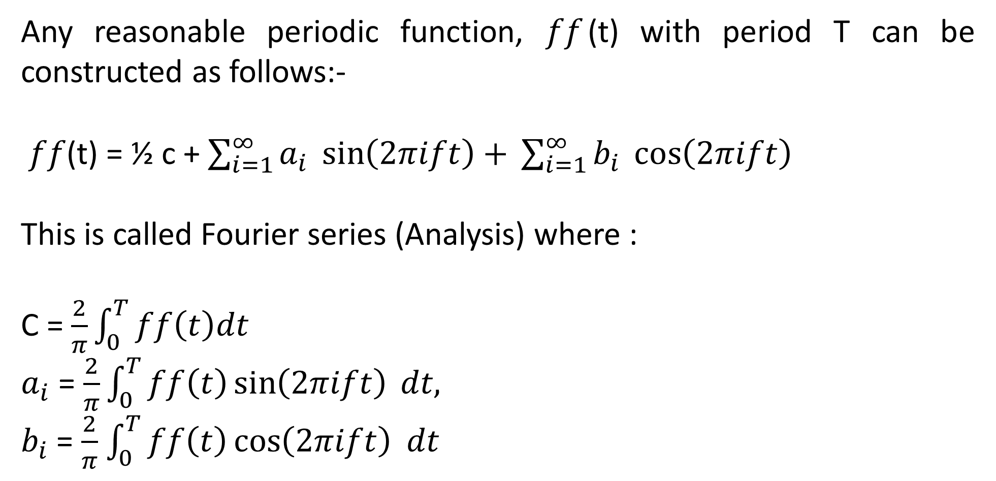
Physical Layer
Any reasonable periodic function, $ff$(t) with period T can be constructed as follows:-
$ff$(t) = ½ c + $\sum_{i=1}^{∞}{a_{i} \sin\left(2πift\right)+ }\sum_{i=1}^{∞}{b_{i} \cos\left(2πift\right) }$
This is called Fourier series (Analysis) where :
C = $\frac{2}{π}\int_{0}^{T}{ff\left(t\right)dt }$
$a_{i}$ = $\frac{2}{π}\int_{0}^{T}{ff\left(t\right)}\sin\left(2πift\right) dt,$
$b_{i}$ = $\frac{2}{π}$ $\int_{0}^{T}{ff\left(t\right)}\cos\left(2πift\right)$ $dt$

Slide 5

Definitions:
Signaling Speed :
The number of times per second that the signal changes its value, this is musured in “baud”.
A B band line does not necessarily transmit b bits/second. If the voltages levels 0,1,2,..,7 were used, then each signal value could be used to represent 3 bits, so the bit rate = 3b.
If only 0’s and 1’s are being used as signal level (“1” binary may be any voltage level) so the bit Rate = band Rate = b.

Slide 6
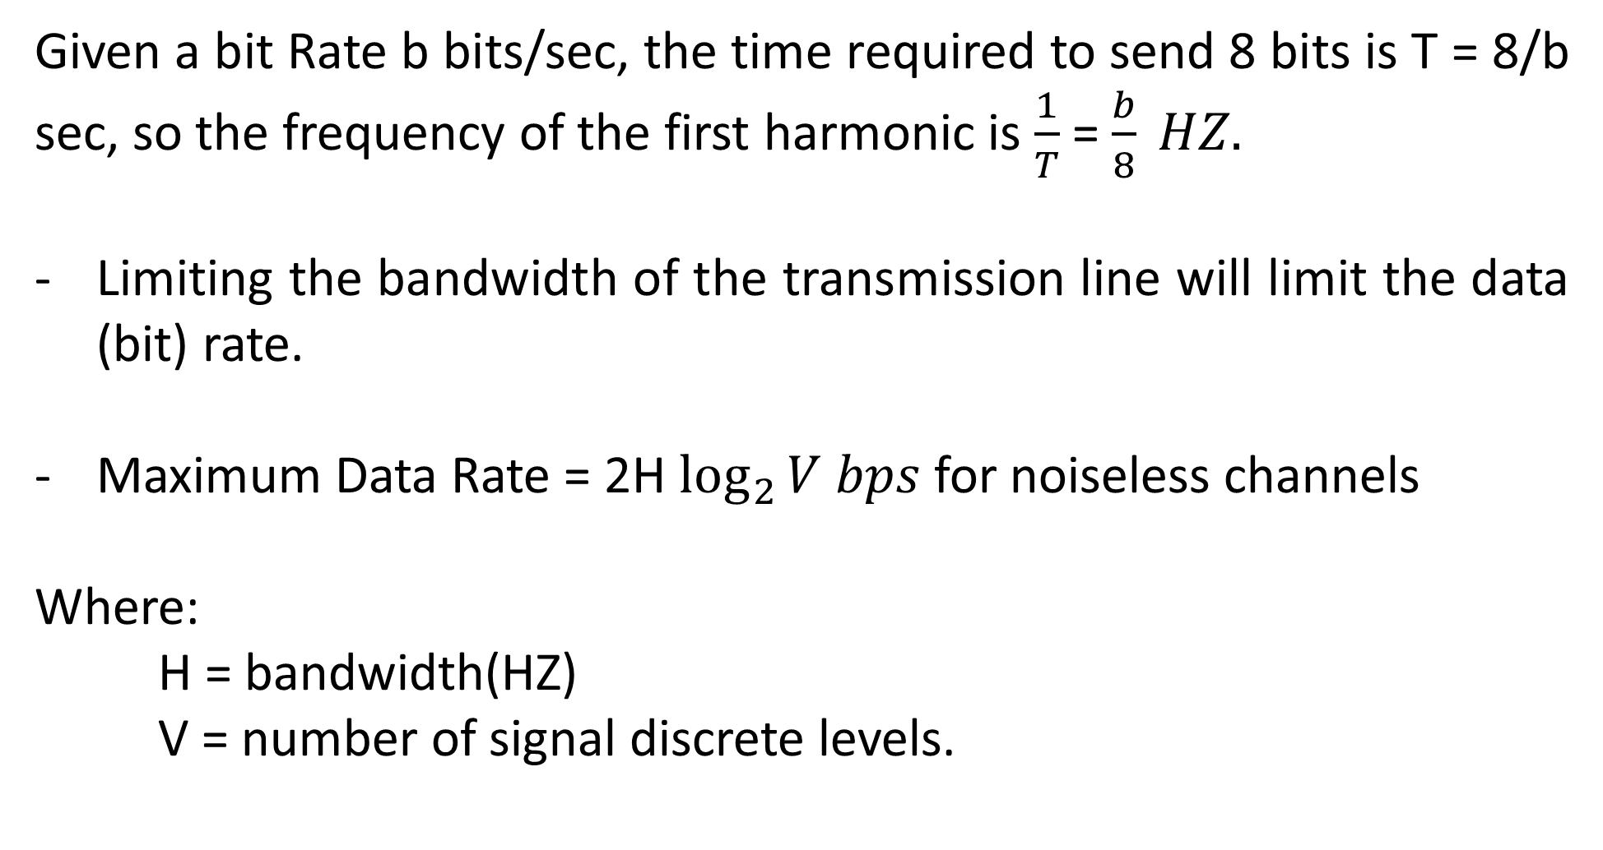


Example:
Given a bit Rate b bits/sec, the time required to send 8 bits is T = 8/b sec, so the frequency of the first harmonic is $\frac{1}{T}$ = $\frac{b}{8} HZ.$
Limiting the bandwidth of the transmission line will limit the data (bit) rate.
Maximum Data Rate = 2H $\log_{2}{V bps }$for noiseless channels
Where:
H = bandwidth(HZ)
V = number of signal discrete levels.

Slide 7
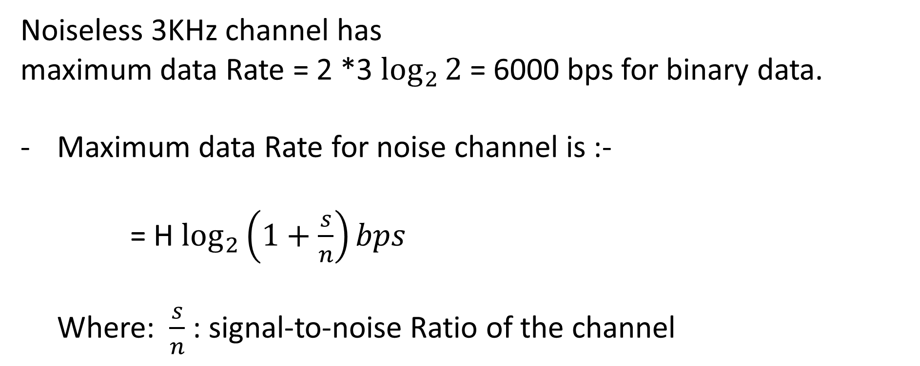
Example:
Noiseless 3KHz channel has
maximum data Rate = 2 *3 $\log_{2}{2}$ = 6000 bps for binary data.
Maximum data Rate for noise channel is :-
= H $\log_{2}\left(1+\frac{s}{n}\right)bps$
Where: $\frac{s}{n}$ : signal-to-noise Ratio of the channel

Slide 8
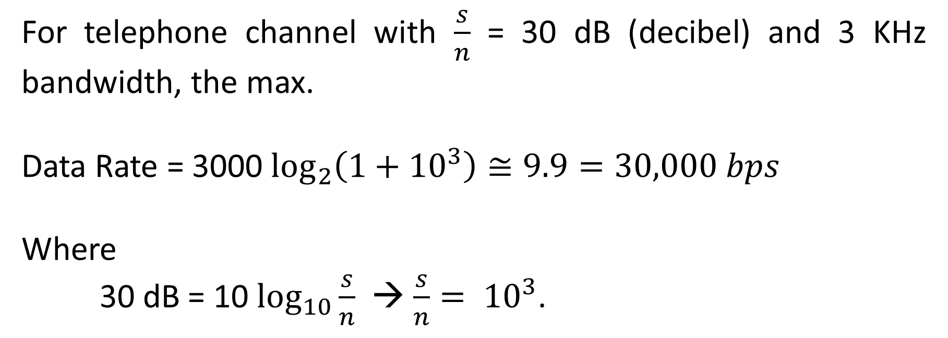

Example:
For telephone channel with $\frac{s}{n}$ = 30 dB (decibel) and 3 KHz bandwidth, the max.
Data Rate = 3000 $\log_{2}\left(1+{10}^{3}\right)≅9.9=30,000 bps$
Where
30 dB = 10 $\log_{10}{\frac{s}{n}}$ → $\frac{s}{n}= {10}^{3}$.

Slide 9
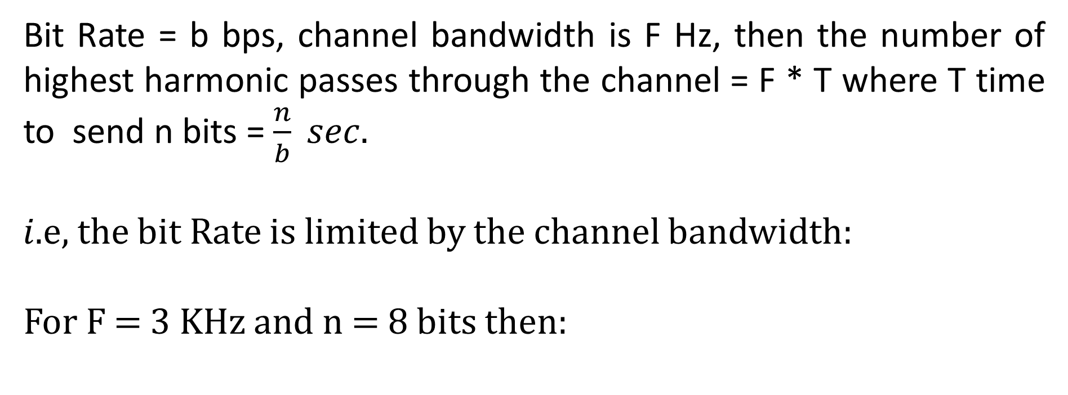
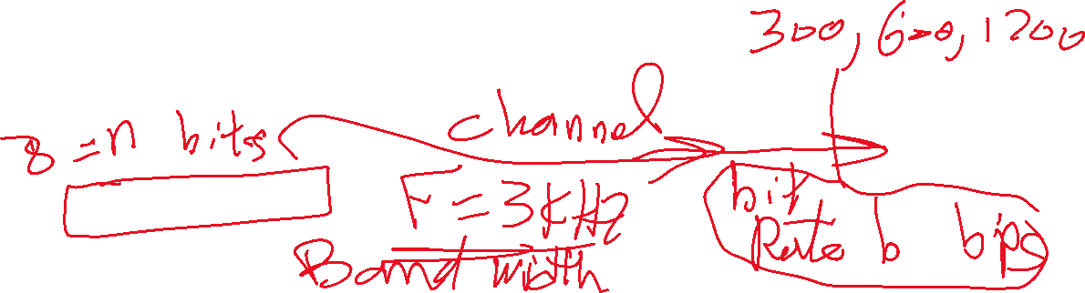
Example:
Bit Rate = b bps, channel bandwidth is F Hz, then the number of highest harmonic passes through the channel = F * T where T time to send n bits = $\frac{n}{b} sec.$
𝑖.e, the bit Rate is limited by the channel bandwidth:
For F = 3 KHz and n = 8 bits then:

Slide 10

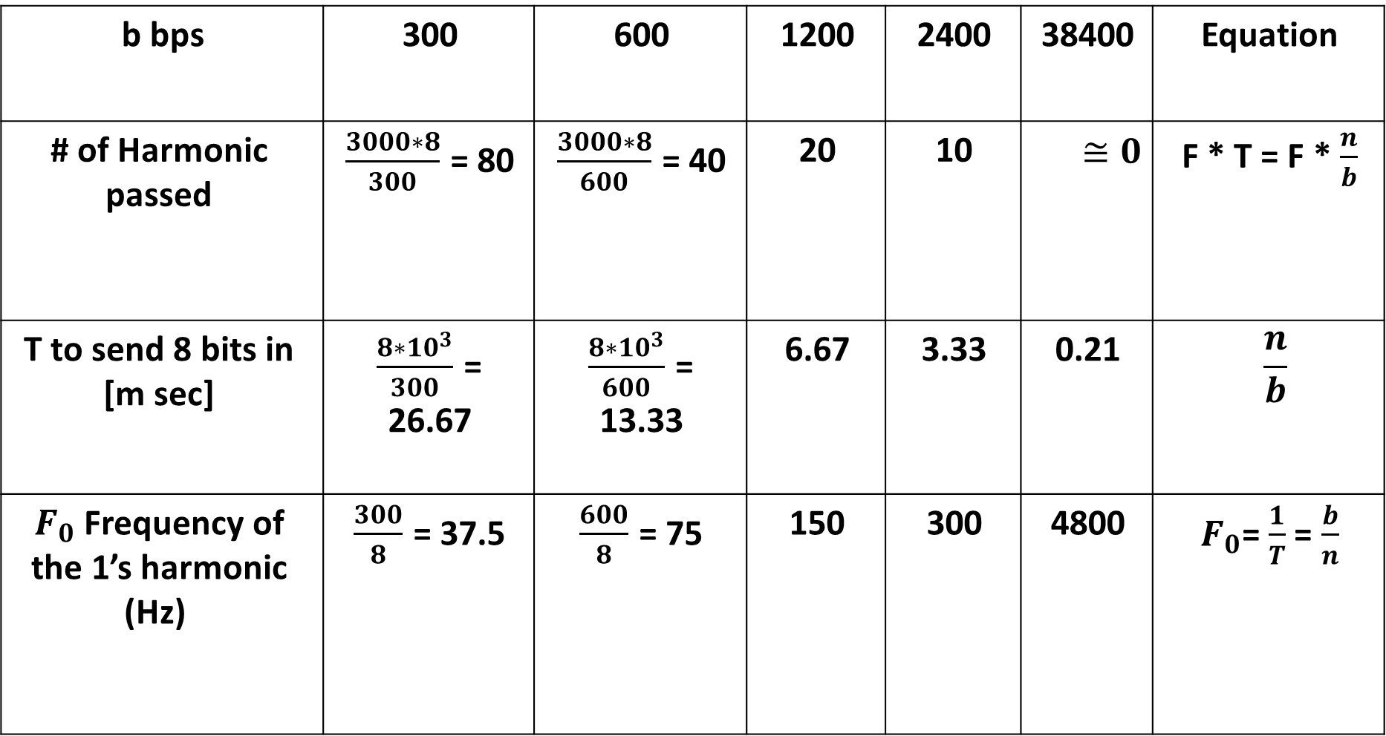

Equation | 38400 | 2400 | 1200 | 600 | 300 | b bps
F * T = F * $\frac{n}{b}$ | $$≅0$$ | 10 | 20 | $\frac{3000∗8}{600}$ = 40 | $\frac{3000∗8}{300}$ = 80 | # of Harmonic passed
$$\frac{n}{b}$$ | 0.21 | 3.33 | 6.67 | $\frac{8∗{10}^{3}}{600}$ = 13.33 | $\frac{8∗{10}^{3}}{300}$ = 26.67 | T to send 8 bits in [m sec]
$F_{0}$= $\frac{1}{T}$ = $\frac{b}{n}$ | 4800 | 300 | 150 | $\frac{600}{8}$ = 75 | $\frac{300}{8}$ = 37.5 | $F_{0}$Frequency of the 1’s harmonic (Hz)

Slide 11
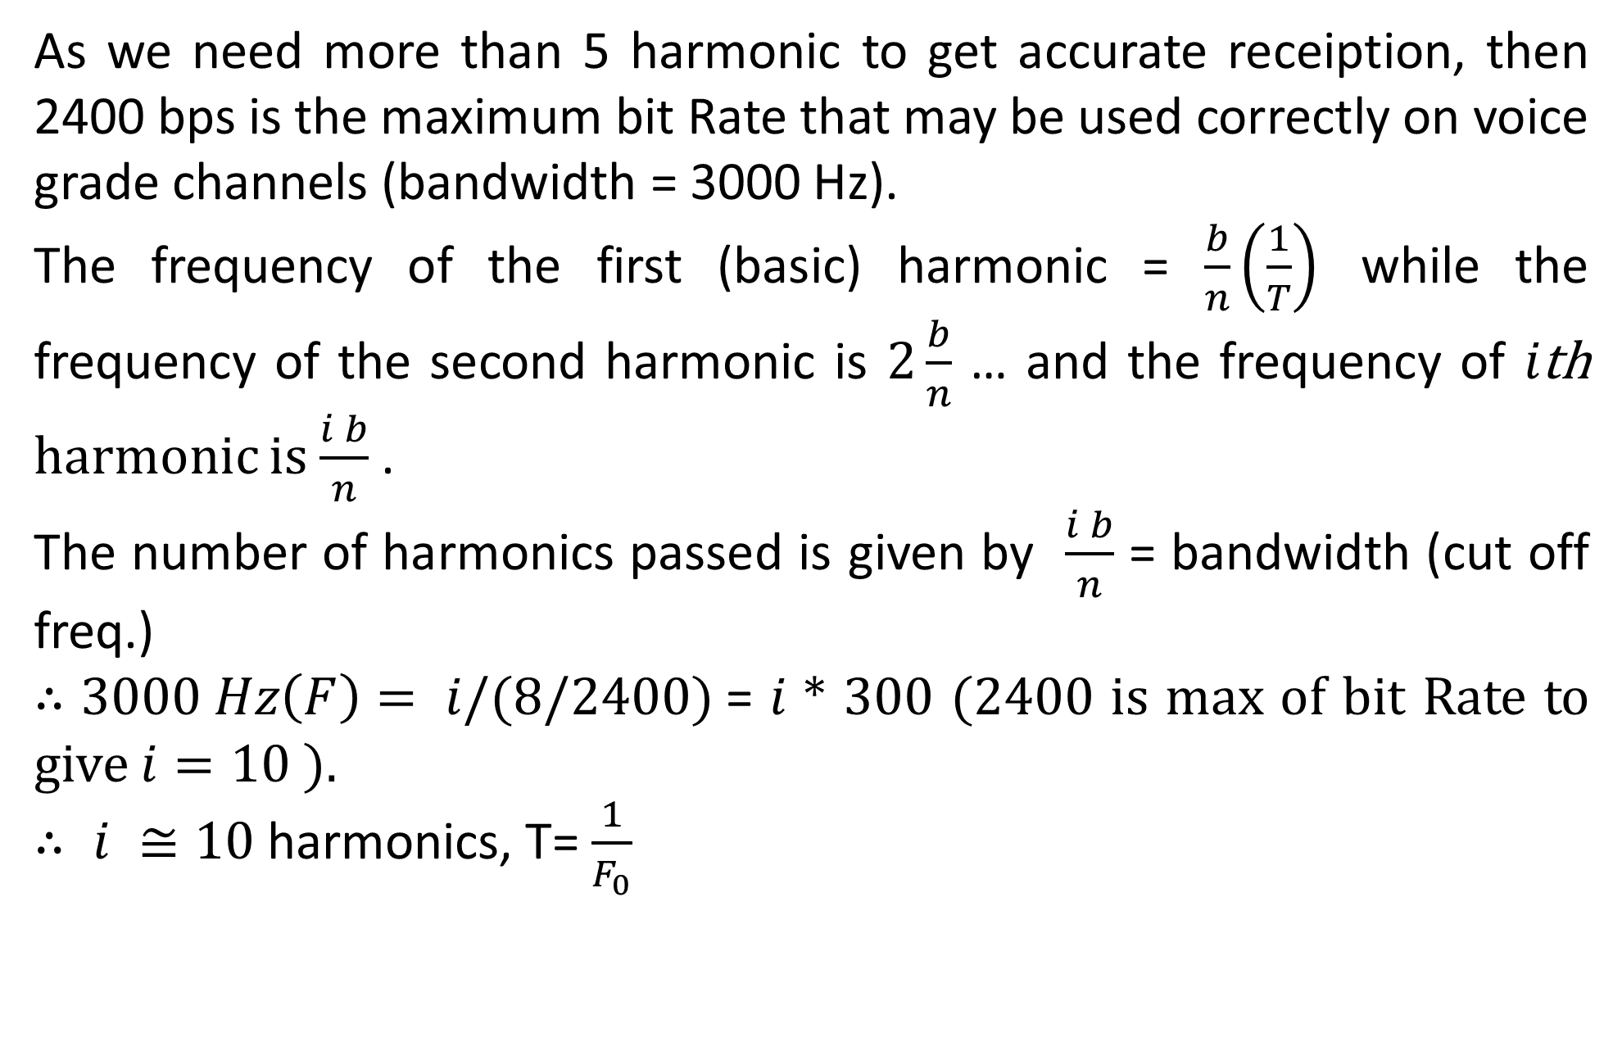
As we need more than 5 harmonic to get accurate receiption, then 2400 bps is the maximum bit Rate that may be used correctly on voice grade channels (bandwidth = 3000 Hz).
The frequency of the first (basic) harmonic = $\frac{b}{n}\left(\frac{1}{T}\right)$ while the frequency of the second harmonic is $2\frac{b}{n}$ … and the frequency of 𝑖th harmonic is $\frac{i b}{n}$ .
The number of harmonics passed is given by $\frac{i b}{n}$ = bandwidth (cut off freq.)
$∴3000 Hz\left(F\right)= i/(8/2400)$= 𝑖 * 300 (2400 is max of bit Rate to give $i=10$).
$∴ i ≅10$harmonics, T= $\frac{1}{F_{0}}$

Slide 12

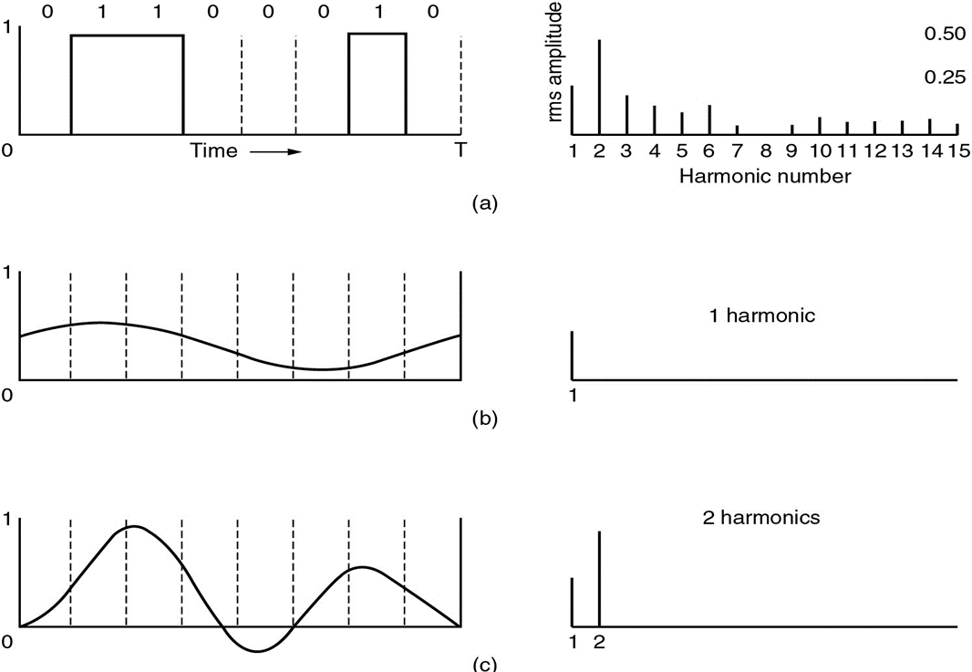
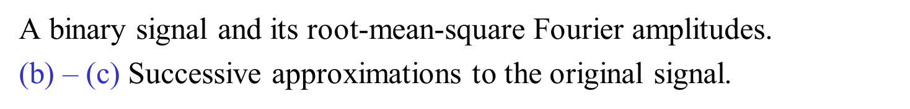

Slide 13

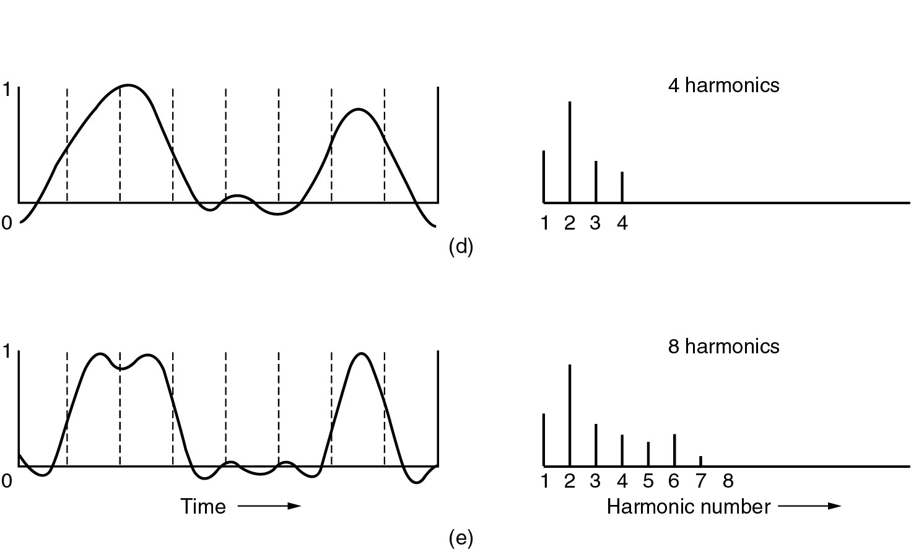
(d) – (e) Successive approximations to the original signal.

Slide 14
AC signaling and Modulation
A pair of copper wires running between the subscriber’s telephone and an end office can carry traffic at 1 M bps without any trouble, using AC signaling where a continues tore in the range of 1K to 2K Hz called carrier is introduced.

Slide 15

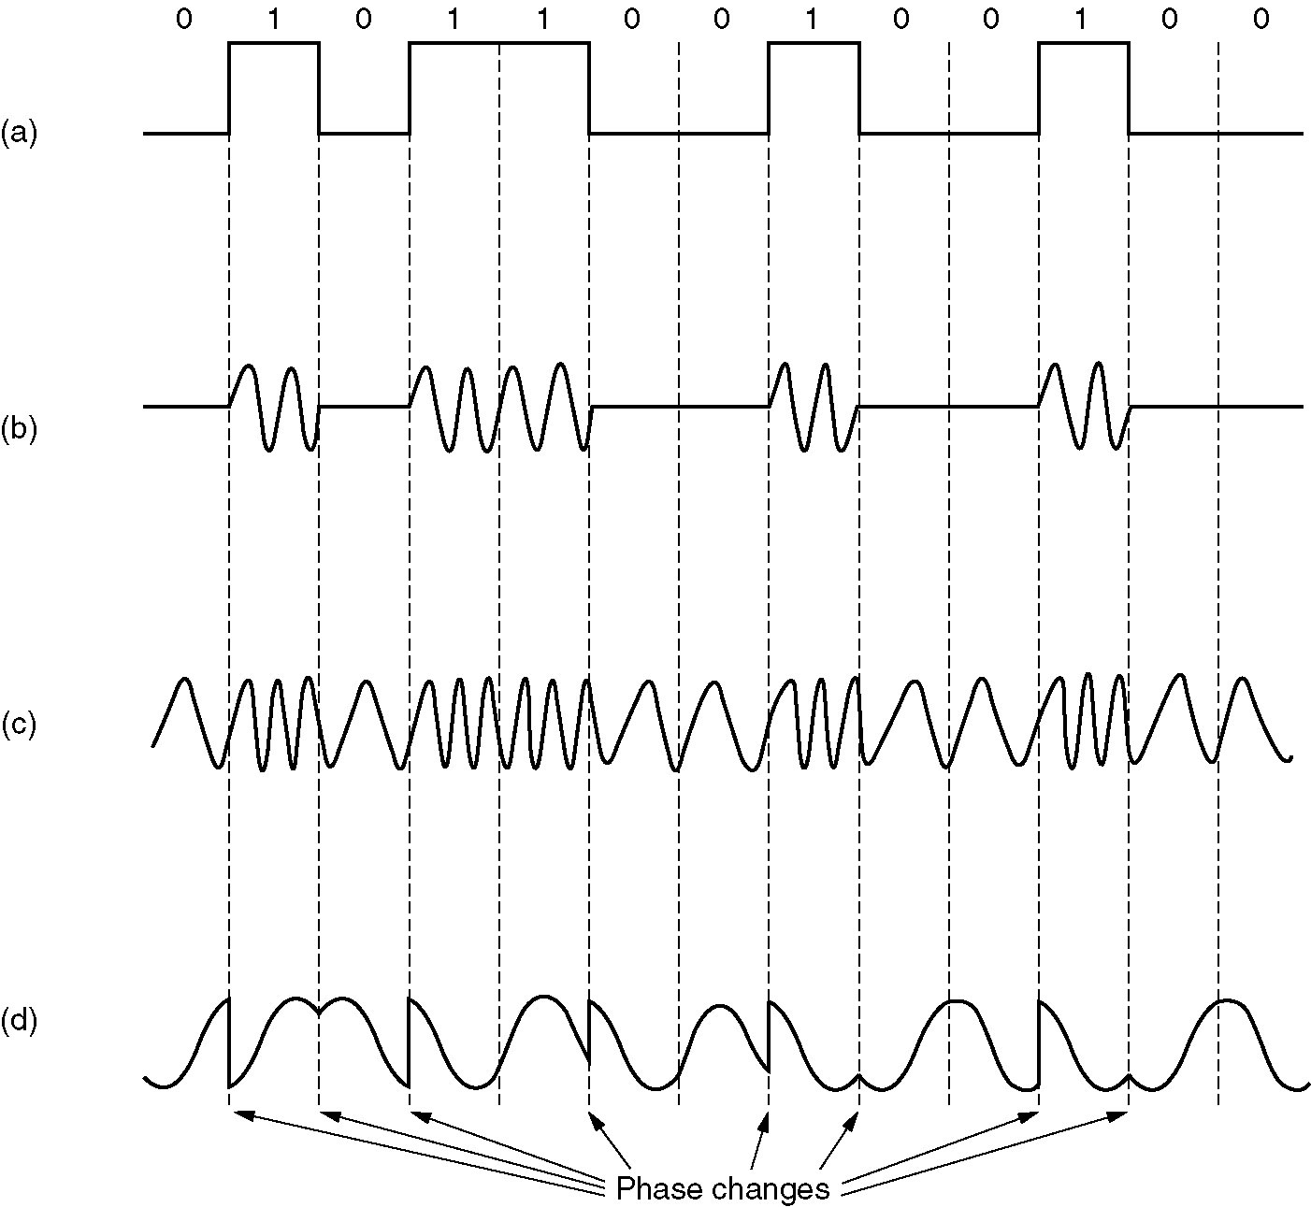
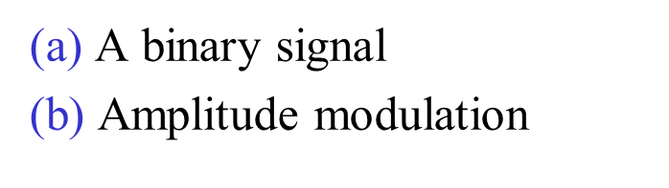
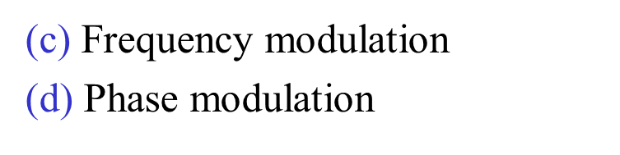
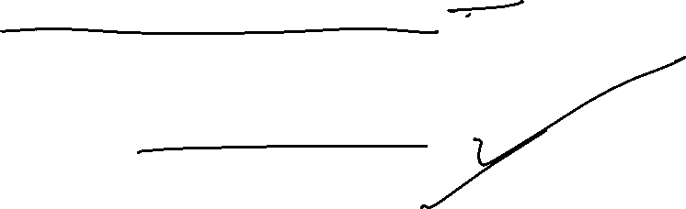

Slide 16









Transmission and Multiplexing
Frequency Division Multiplexing (FDM):
The frequency spectrum is divided up among the user’s (each has his view) of the physical channel (logical channel) where each user possesses a specified frequency band.
2. Time Division Multiplexing (TDM):
Take turns (in a round robin), each one periodically getting the entire bandwidth for a little burst of time.

Slide 17







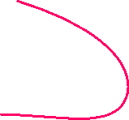

































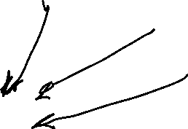















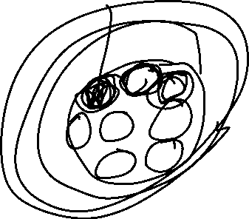

Slide 18















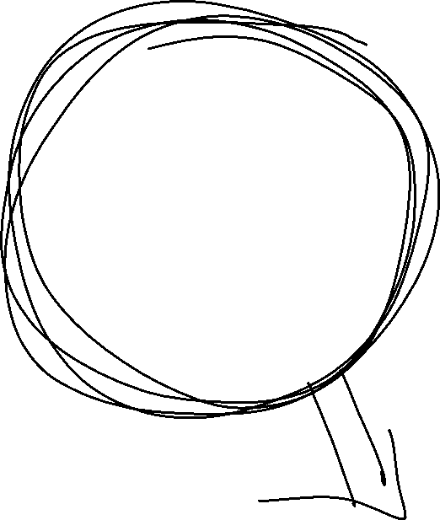







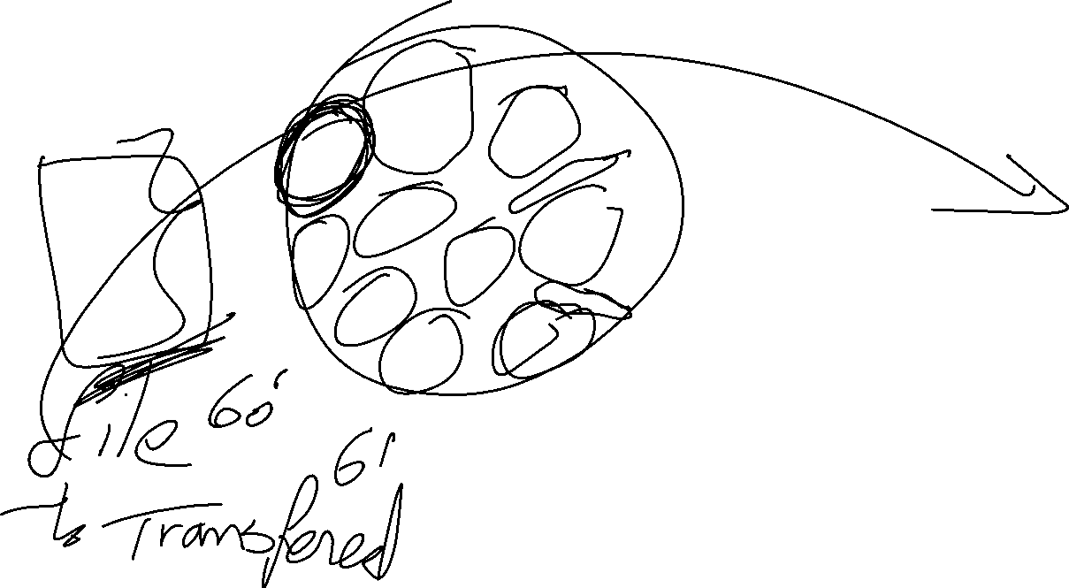










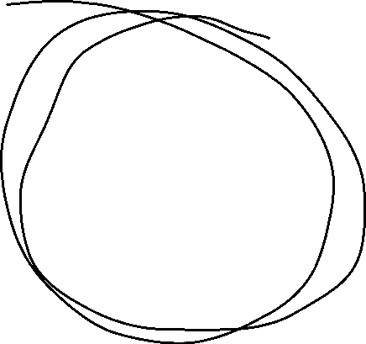






Slide 19
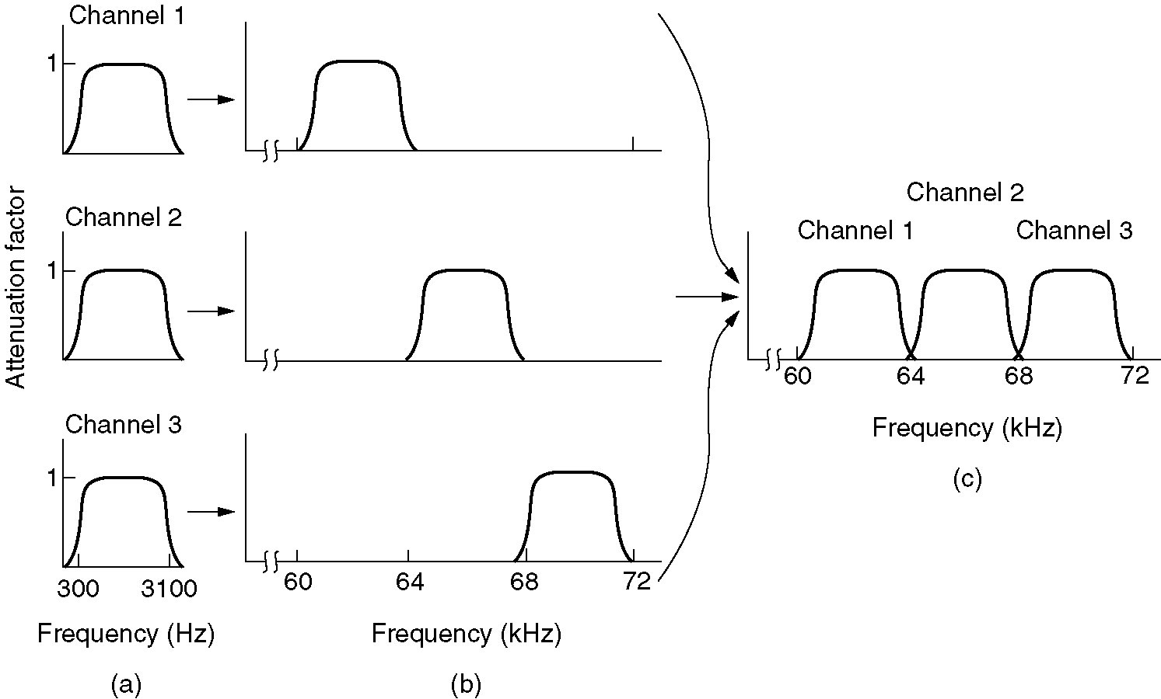






Frequency Division Multiplexing
(a) The original bandwidths.
(b) The bandwidths raised in frequency.
(b) The multiplexed channel.

Slide 20
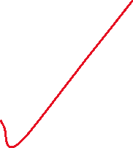

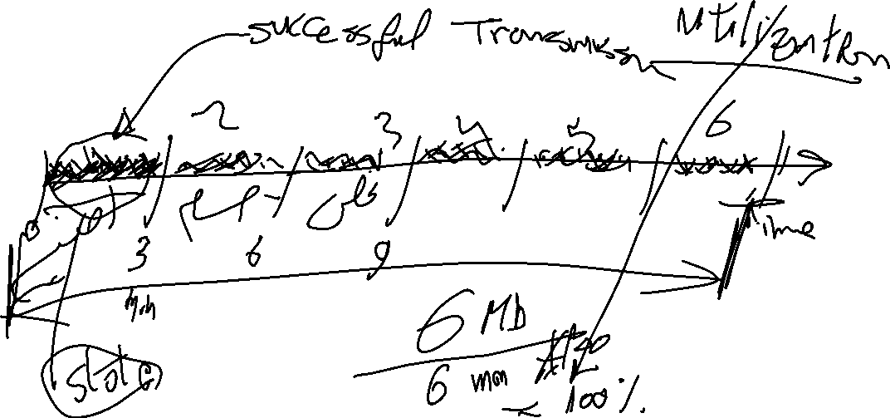
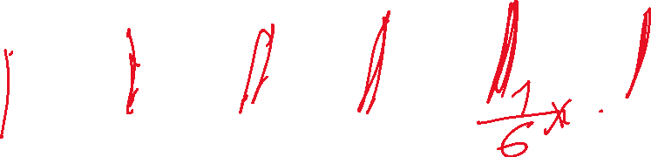


Time Division Multiplexing (TDM)

Slide 21





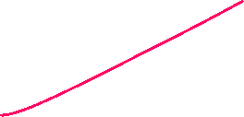




















Slide 22












Communication Satellites
A Communication satellites contains one or more transponders, each of which listens to some portion of spectrum, amplifies the incoming signal, and then rebroadcasts it at another frequency to avoid interface with the incoming signal.
At an altitude of 36,000 Km, the satellite period is 24 hrs. The satellite seems to be hanged in a fixed spot in the sky. It is unwised to have satellites spaced much closer than 4 degrees (8 degrees for TV (high power)) using the same frequency spectrum and hence we can have only 36014 = 90 geosynchronous.

Slide 23
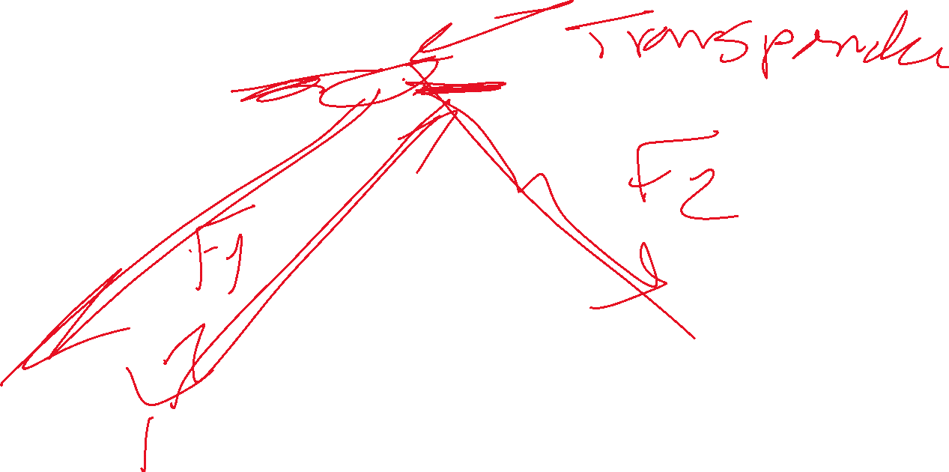
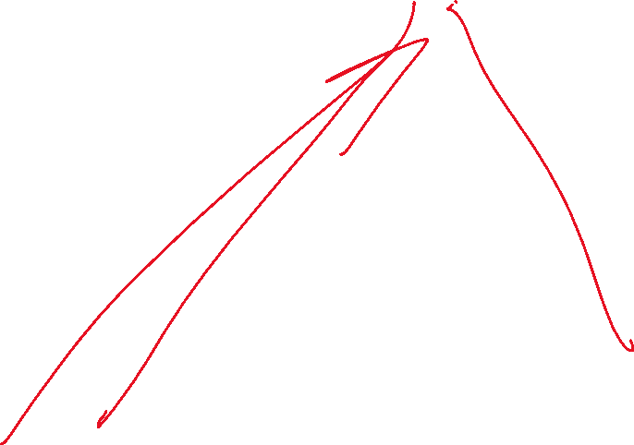
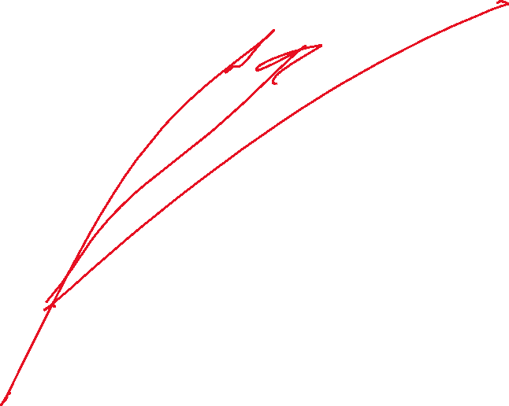

Slide 24









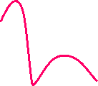



































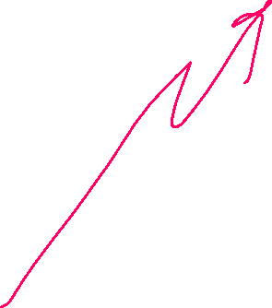


Slide 25

Communication satellites in the sky at once frequency 3.7 → 6.4 GHz (Competition of orbit slots).
Satellites using different parts of the spectrum do not compete.
The microwave short band (12/14 GHz) requires that the satellites be separated by 1 degree but the storms and rains absorb these short microwave signals. Since storms are localized, we can use several ground stations to get around this problem.

Slide 26




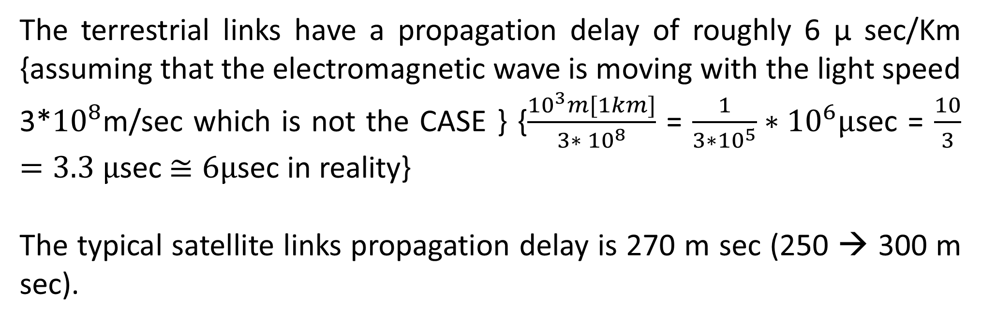



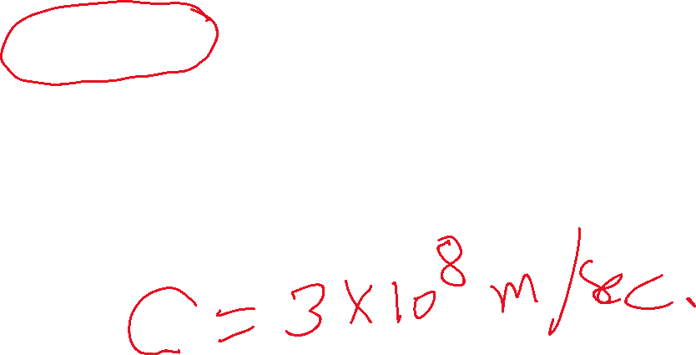

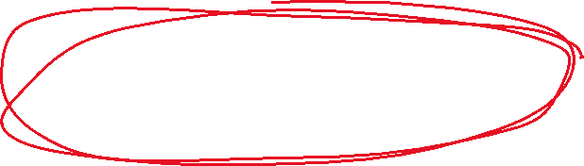
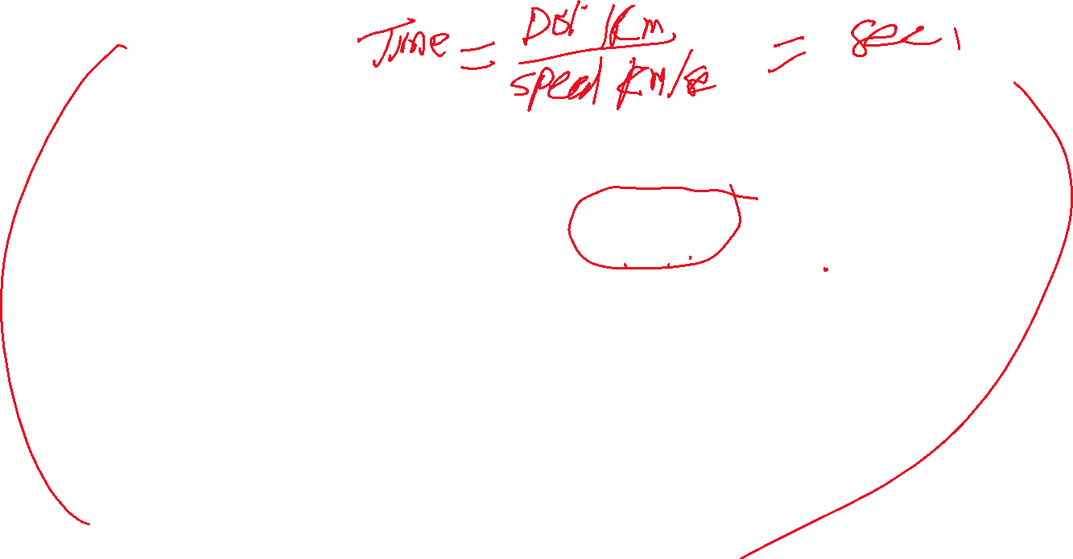





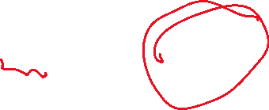
The terrestrial links have a propagation delay of roughly 6 µ sec/Km {assuming that the electromagnetic wave is moving with the light speed 3*${10}^{8}$m/sec which is not the CASE } {$\frac{{10}^{3}m[1km]}{3∗ {10}^{8}}$ = $\frac{1}{3∗{10}^{5}}∗{10}^{6}µ$sec = $\frac{10}{3}=3.3 µ$sec $≅6µ\text{sec}$ in reality}
The typical satellite links propagation delay is 270 m sec (250 → 300 m sec).

Slide 27
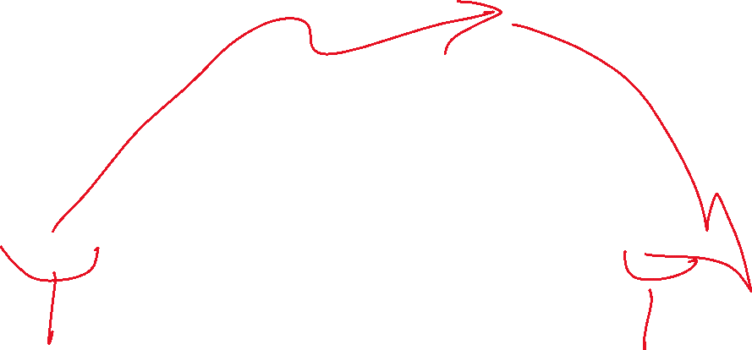
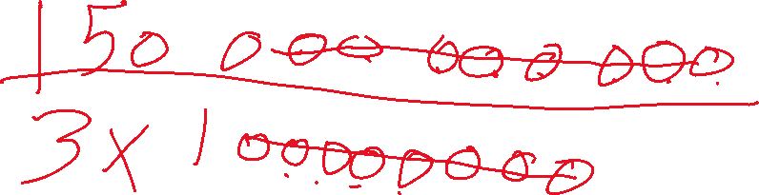
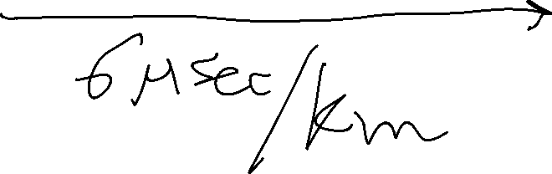

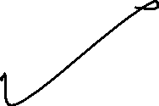
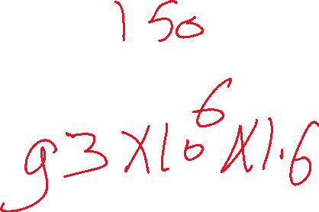
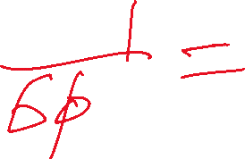



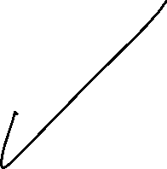
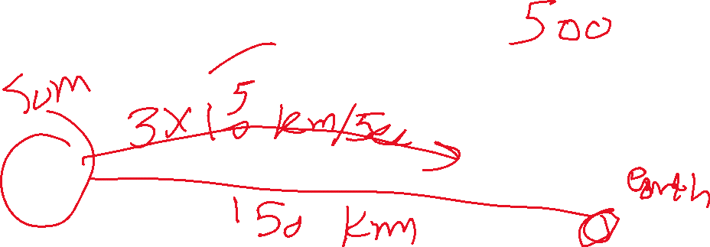

Slide 28



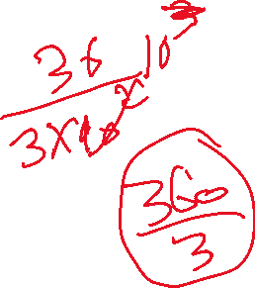


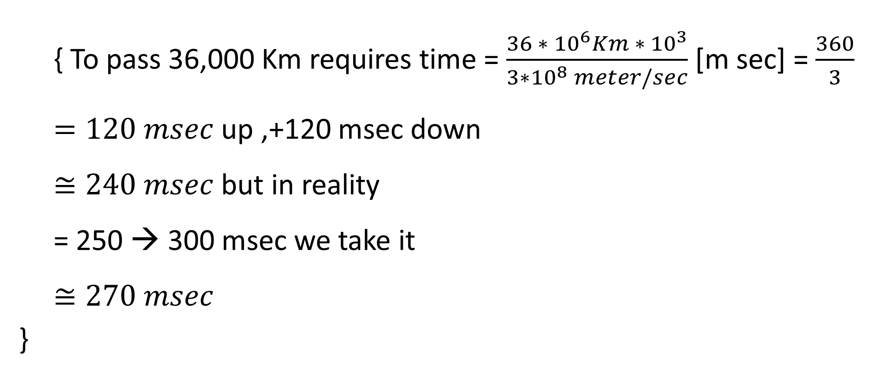





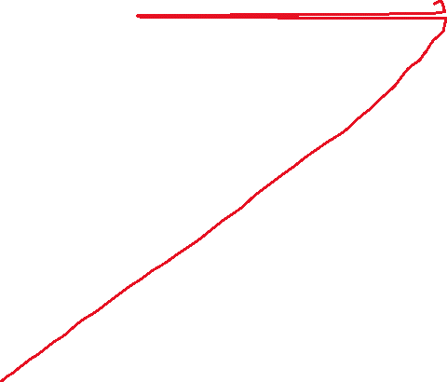



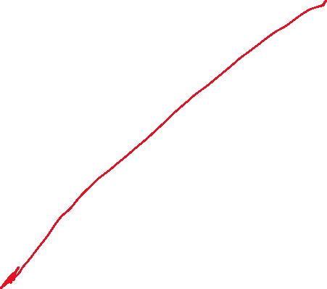
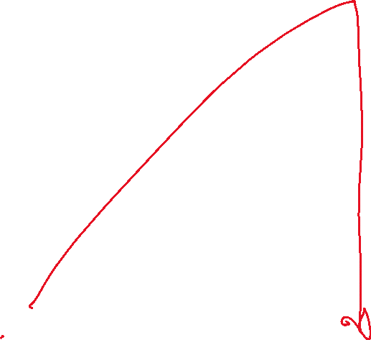



{ To pass 36,000 Km requires time = $\frac{36 ∗ {10}^{6}Km ∗ {10}^{3}}{3∗{10}^{8} meter/sec}$ [m sec] = $\frac{360}{3} =120 msec$ up ,+120 msec down
$≅240 msec$but in reality
= 250 → 300 msec we take it
$$≅270 msec$$
}

Slide 29





















The total delay to send X K bits over a 9600 bps terrestrial links is $\frac{X ∗ {10}^{3}}{9600}$ sec, while sending the same message over 5-Mbps satellite link requires 270 ms + $\frac{X ∗{10}^{3}}{5∗{10}^{6}} ms .$
If X is longer than 2.6 K bits then the satellite is faster, and the propagation delay is independent of the distance between sender and receives (cost is independent of the distance traversed).

Slide 30




The storms and rains absorb the short microwave signals. Since storms are localized, we can use several ground stations to get around this problem.
The terrestrial links have a propagation delay of roughly 6 µsec/Km. The typical satellite links propagation delay is 270 ms (light speed 300,000 Km/sec).The total delay to send X K bits over a 9600 bps terrestrial links is x*1000/9600 sec, while sending the name message over a 5 Mbps satellite link requires 270 mst x/(5*${10}^{6}$) ms → if x is longer than 2.6 K bits, then the satellite is faster, and the propagation delay is independent of the distance between sender and receiver (cost is independent of the distance traversed).

Slide 31
The highest speed leased lines is running at 56 Kbps while the satellite can offer 50 Mbps.
The Message that requires 7 hours to be sent over 56 Kbps link would require 30 seconds using 50 Mbps satellite link.

Slide 32




The advantages of satellite links are :
High bit rate (typically 50 Mbps).
Lower propagation delay compared with terrestrial links for a message length > 2.6 K b.
Cost is independent of distance between sender and receiver.
Circuit cost = 150 per year (50 Mbps = ${10}^{5}$ telephone (voice grade)channel)… satellite cost = 20-30 M+ 20-30 M for launching +ground station cost (tens of thousands),… service time = 10 years.

Slide 33

Total delay to transmit X K bit over terrestrial links with 9600 bit rate bps is $T_{1}$[mesec] = $\frac{X ∗ {10}^{3}∗{10}^{3}}{9600}$
Total delay to transmit the same packet over satellite link with 5 Mbps $T_{2}\left[mesec\right]=270+ \frac{X ∗{10}^{3}∗{10}^{3}}{5 ∗ {10}^{6}}$

Slide 34












Compare $T_{1} \& T_{2}$
$$T_{1} for X=2.6 Kbits.$$
$T_{1}= \frac{2600∗ {10}^{3}}{9600}$ = 270.83 mesec.
$T_{2}=270+ \frac{2600∗{10}^{3}}{5∗{10}^{6}}$ = 270+ 0.52 = 270.52 mesec.
$$∴ T_{2}< T_{1}$$
For X < 2.6 Kbits let X= 2.5 Kb.
$$T_{1}=\frac{2500∗ {10}^{3}}{9600}=260.42$$
$$T_{2}=270+?=270$$
$$∴T_{1}<T_{2}$$

Slide 35

Packet switching and circuit switching

Slide 36


Circuit switching(telephone calls)
Once a call has been set up, a dedicated path between both ends exists, and will continue to exist until the call is finished. This path may be physical copper path or physical microwave path.

Slide 37












packet switching and Message switching
A- Store and forward network
no physical path is established in advance between the sender and receiver. When the sender has same thing to send (message of any size or packet of specified upper limit of length), it is “stored” available IMP and then forwarded later, one hop at a time.
Each block is transmitted and received in its entirely, inspected for errors, and then retransmitted.

Slide 38

B- Packet switching networks
They place a tight upper limit on the block size to be transmitted.
This will allow the packets to be buffered in IMP main memory.
In the circuit switching, the physical connection is strictly reserved in advance before the transmission starts, whereas packet switching acquires and releases the bandwidth as it is needed.. .. .. Waste of bandwidth in circuit switching.

Slide 39



























Circuit Switching
(a) Circuit switching.
(b) Packet switching.

Slide 40

























Message Switching
(a) Circuit switching (b) Message switching (c) Packet switching

Slide 41







Packet Switching
A comparison of circuit switched and packet-switched networks.

Slide 42

Circuit switching : Acquire a physical connection, in advance, before the transmission starts till the end whether there are samething to send of not telephone calls.
Packet switching: acquire the physical connection to transmit a packet and release the circuit immediately …. No bandwidth waste.

Slide 43


A- Datagram
Postal service send the packet to all the outgoing lines except the incoming one, the packet header has the destination address.
B- virtual circuit
Given the virtual circuit No → path can be determined. The path is the same for a given virtual circuit.

Slide 44
Virtual circuit switching (through)…”telephone”
The packet header is examined as soon as it arrives, to determine the appropriate outgoing line.
If that line is free, retransmission is begun immediately, without waiting for the complete packet. If, however, the line is busy, the packet is stored and forwarded later.
The packet header contains the virtual circuit address(number) instead of the full destination address. The virtual circuit number (address) is unique, it defines the path between two hosts.

Slide 45
The destination address is specified during the setup time. The packets passe from host to host in order, and arrive to the destination host in order.

Slide 46
Datagrams …”postal service”
The packets are transmitted as insolated items. Each packet header should contain the full destination address (the machine and the object on the machine). When a packet reaches an IMP, the IMP sends it on an outgoing line (nothing in the packet is modified)….. No error.

